Slide 1
Boosting Algorithms

Slide 2
ADA Boosting
AdaBoost works by weighting the instances in the training dataset based on the accuracy of previous classifications.
These algorithms boost prediction power by transforming a large number of weak learners into strong learners
Boosting algorithms work on the idea of first building a model on the training dataset and then building a second model to correct the faults in the first model. This technique is repeated until the mistakes are reduced and the dataset is accurately predicted. Boosting algorithms function similarly in that they combine numerous models (weak learners) to produce the final result (strong learners).

Slide 3
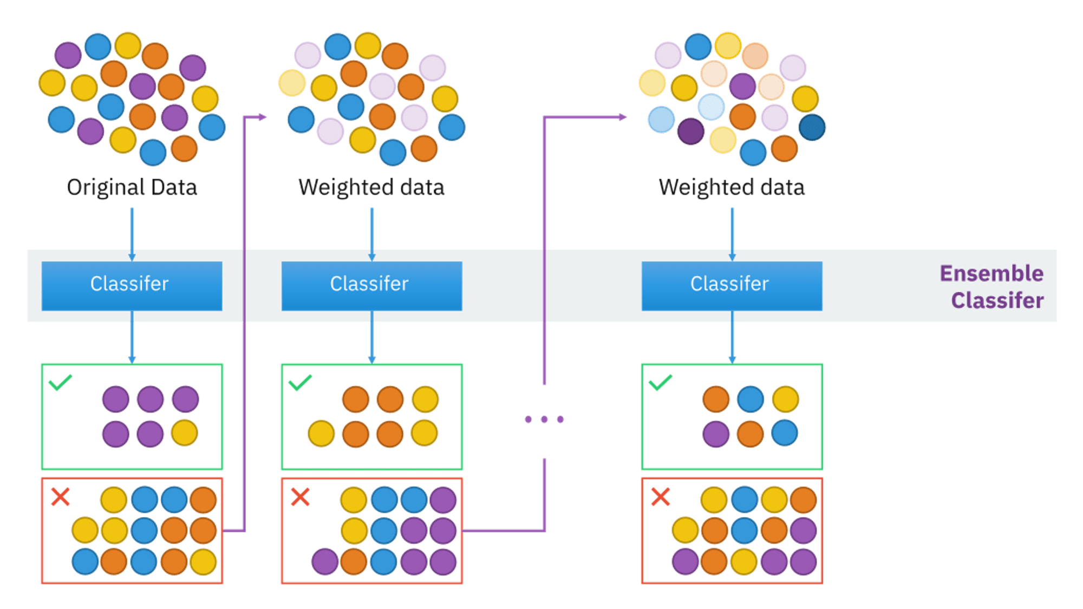
ADA Boosting

Slide 4
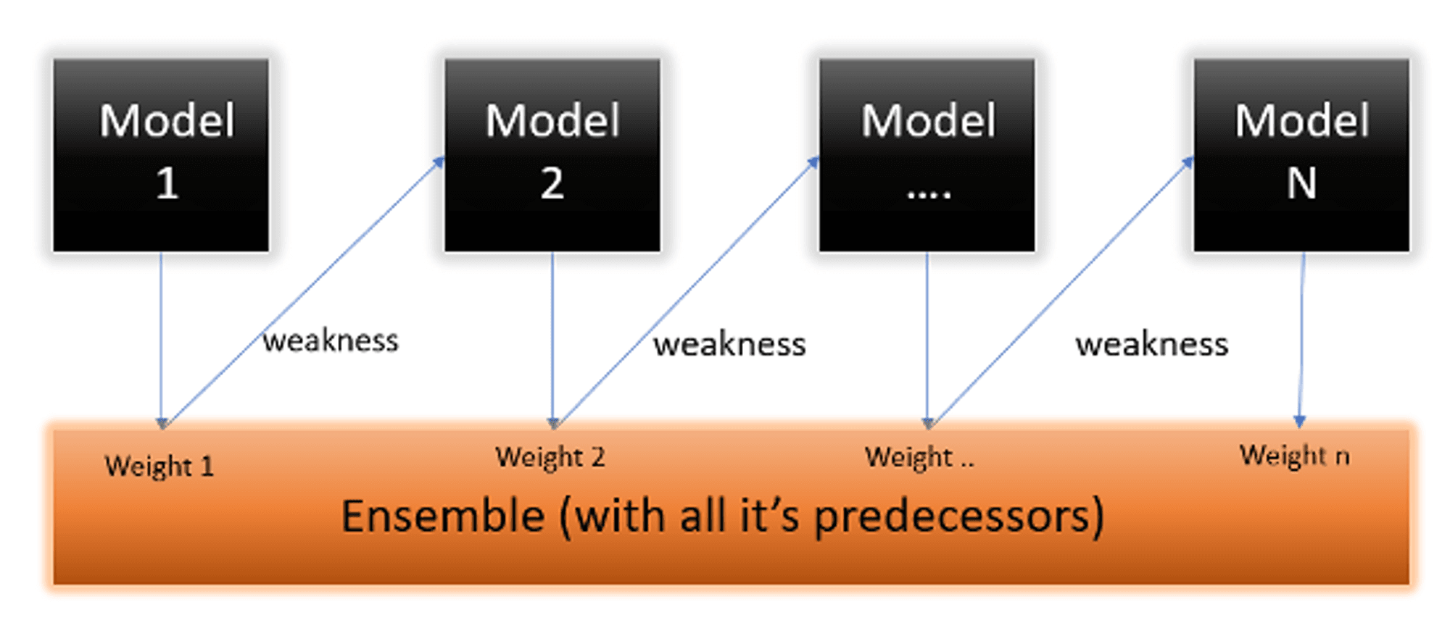
Ada Boosting

Slide 5
Ada Boosting
Advantages
Can handle binary and multi-class classification problems.
Can handle noisy data and outliers
Often results in high accuracy and outperforms other algorithms in many scenarios
Disadvantages
Sensitive to noisy data and outliers that are not properly preprocessed.
Can be computationally expensive, especially with large datasets
Requires careful parameter tuning to achieve optimal performance

Slide 6
XGBoosting
XGBoost (eXtreme Gradient Boosting) is a machine learning algorithm that focuses on computation speed and model performance.The algorithm can be used for both regression and classification tasks and has been designed to work with large and complicated datasets.
The model improves sequentially but not in incremental weight concept
Optimize the loss function(error) from previous learner
Using Additive Model for regularize loss function
Distributed machine learning process
More computational speed and model efficiency

Slide 7
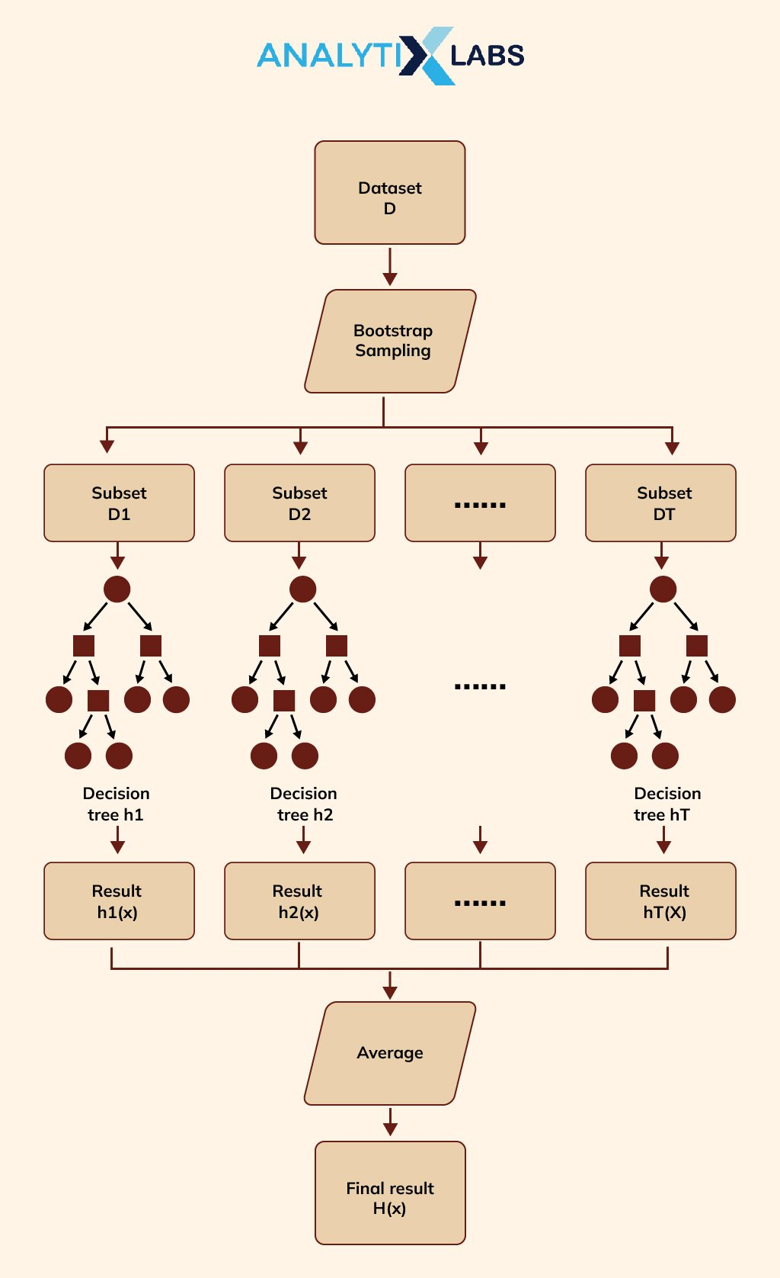
XG Boosting

Slide 8
XG Boosting
Advantages
XGBoost is known for its speed and scalability, making it a good choice for large datasets
XGBoost has been shown to outperform other machine learning algorithms in many benchmark tests
XGBoost can be used with a variety of data types and can handle missing data
XGBoost applies regularization to prevent overfitting and improve generalization

Slide 9
XG Boosting
Disadvantages
XGBoost is a complex algorithm that requires some understanding of its underlying mechanics
XGBoost can require significant computational resources, especially when using large datasets or many iterations
XGBoost has several hyperparameters that need to be tuned for optimal performance

Slide 10
LGBM
Light GBM is very fast when compared to XGBOOST and is a much better approach when dealing with large datasets
Poor in small dataset
It uses histogram-based method selecting best fit
For continues values split-up into bin or buckets

Slide 11
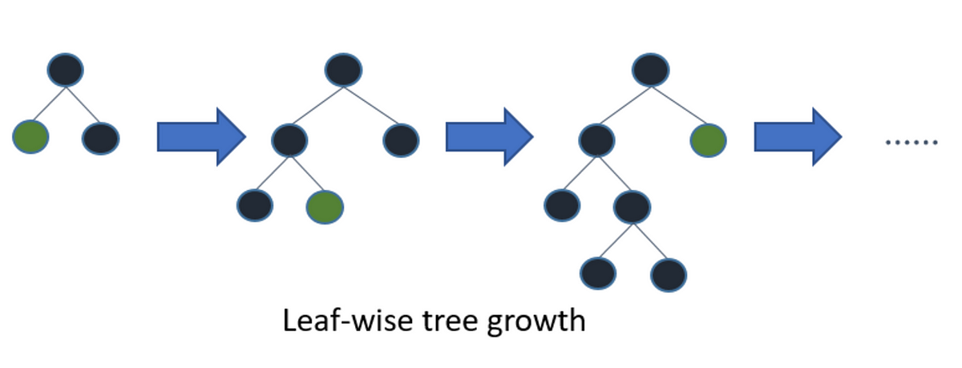
LGBM

Slide 12
LGBM
Advantages
Light GBM uses a histogram-based algorithm. So its faster training speed and higher efficiency
Replaces continuous values to discrete bins which results in lower memory usage
It produces much more complex trees by following leaf wise split approach rather than a level-wise approach which is the main factor in achieving higher accuracy
It is capable of performing equally well with large datasets with a significant reduction in training time as compared to XGBoost

Slide 13
LGBM
Disadvantages
Light GBM split the tree leaf-wise which can lead to overfitting as it produces much complex trees
Poor in small dataset

